Slide 1

Interview Skills and Resume Preparation For HiveEdians
STAFF’S COPY
Here is where your journey for your dream begins

Slide 2
List of contents
01
02
03
Life Skills
Interview Skills
Resume’ Preparation

Slide 3
01
Life Skills
The things you should know about

Slide 4
PRESENTATION
Presentation deals about the inner confidence, Understanding of the concepts and the way of delivery.
Rules of Presentation:
Stable and confident posture
Eye contact should be focussed towards audience
Use smooth hand gestures
Do not cross your hands across chest(As Communication flows from heart to heart).
No hands in your pocket while speaking
Keep your hands on neutral position
Take cue cards/Points to remember cards.
Types of Presentation and tips to handle.
1.Team Presentation.(Allocate separate topics for each member,and co-ordiantion with delivery is also crucial)
2.Non-Technical Presentation.(Be strong in way of delivery and personal experiences is needed)
3.Technical Presentation.(Be strong in content and way of delivery
4.Paper Presentation.(Be too consious about the topic , prepare well in result discussion)

Slide 5
Steps in Presentation
Step 1: Wish and great audience in a polite and energetic manner.
Step 2: Introducing yourself in a stylish and unique manner.
Step 3: Intro about the topic
Step 4: Give the Handouts if needed(Pamplets, Worksheets,Forms etc)
Step 5: -Moving to the topic tips
-It should be like a story , use case studies if possible.
-Use facts and figures properly with some sense of humour and
also add personal experiences if needed.
Step 6: Thanking Speech/Farewell speech.
Step 7: Q&A session/Interactive session.
Step 8: Ask for feeback/Photo session if needed.
PRE-PRESENTATION TIP:
ALL THE A.V EQUIPMENTS AND CONTENTS OF PAMPLETS SHOULD BE CHECKED

Slide 6
TIPS TO AVOID PRESENTATION ANXIETY
Prepare and present a known topic to yourself first.
Present to known people
Present a challenging /unknown topic to known people
Known topic to unknown people
Unknown topic to unknown people
Creative and positive visualization and explanation.
Positive affirmation about yourself is needed first.
Take cue cards/Points to remember cards.

Slide 7
02
Interview Skills
Buckle up and listen

Slide 8

COMMUNICATION TIPS
Always communicate or correspond in complete sentences.
Rate of speech must be in an optimal speed.
Do vocal highlighting/give stress to certain words which are important to convey.
Whenever you say your name say it proudly and confidently.
Always use the endearing words.
Make eye contact with whom you’re speaking but dont’t stare.
Use “PLEASE”,”SORRY”,”THANK YOU” for effective convincing convo.
Use a keyword as a part of your answer which is from the question itself.

Slide 9
SELF-INTRODUCTION
STRUCTURE:
GREETINGS
NAME AND QUALIFICATION WITH INSTITUTION
PLACE.
SKILLS,COURSES AND OTHER QUALIFICATIONS.
INTERNSHIPS/WORK EXPERIENCE.
BEST PROJECTS.(ACCORDING TO THE COMPANY).
INTERESTS AND HOBBIES(IF ANY).
That’s all about me.

Slide 10
ATTIRE AND GROOMING SKILLS
WEAR PLAIN CREAM SHADES AND DARK SHADES OF SHIRTS.
WEAR VERTICALLY MONO-COLOURED STRIPED SHIRTS ONLY.
AVOID FLUROCENT COLOUR.
THE BOTTOM DRESS SHOUBE CONTRAST OF THE TOP DRESS.
WEAR TIE / BOW TIE IF NEEDED.
TRY TO WEAR FORMAL PLAIN BELT AND SHOE AND SHOULD BE IN SAME COLOUR.
TRY TO WEAR SOCKS.
AVOID SLIPPERS.
PUT ON COLOGNE /PERFUME THAT ARE MILD, SHOULD’NT BE THAT STRONG.
AVOID YAWNING.
DON’T GO AGAINST YOUR PRINCIPLES AND ETHICS.
NO COLOURING IN THE HAIR, NEATELY TRIMMED HAIR WITH CLEAN SHAVE IS PREFFERED.
NO RELIGIOUS SYMBOLS , NO STUDS AND NAILS SHOUL BE MAINTAINED PROPERLY.

Slide 11
COMMON HR QUESTIONS
1.Why should I hire you?
I possess the necessary skills and qualities that align with the job
requirements, reflecting my commitment and value to the company. I
am a dedicated team player, always ready to collaborate, contribute,
and support my colleagues, recognizing that effective teamwork is
crucial for success."
2.Why did you decide to apply for this role, and why did you
choose our company?
"I applied for this role because of my genuine passion for it and the
satisfaction it brings. I chose your company because of its
outstanding reputation in the industry, high standards, and exciting
plans for the future that contribute to societal growth."

Slide 12
COMMON HR QUESTIONS
Where do you see yourself in 5 years?
In the next five years, I envision myself improving in terms of competence,
efficiency, and professionalism. I aim to spend the coming years acquiring
new skills, taking on challenging assignments, engaging in a variety of
projects, making substantial contributions, and putting in the necessary
effort to advance to the next level.
What are some of your strengths and weaknesses?
I always strive to be a positive influence on those around me and spread joy wherever I can.
As for my weaknesses, I tend to be a perfectionist and fixate on details,
which can sometimes distract me from the bigger picture. So, feedback is
essential for me, and without it, I can struggle to stay on track and may not
achieve my desired results.

Slide 13
COMMON HR QUESTIONS
Where do you see yourself in 5 years?
In the next five years, I envision myself improving in terms of competence,
efficiency, and professionalism. I aim to spend the coming years acquiring
new skills, taking on challenging assignments, engaging in a variety of
projects, making substantial contributions, and putting in the necessary
effort to advance to the next level.
What are some of your strengths and weaknesses?
I always strive to be a positive influence on those around me and spread joy wherever I can.
As for my weaknesses, I tend to be a perfectionist and fixate on details,
which can sometimes distract me from the bigger picture. So, feedback is
essential for me, and without it, I can struggle to stay on track and may not
achieve my desired results.

Slide 14
03
Resume’ Preparation
A Best Resume’ is all we want.

Slide 15
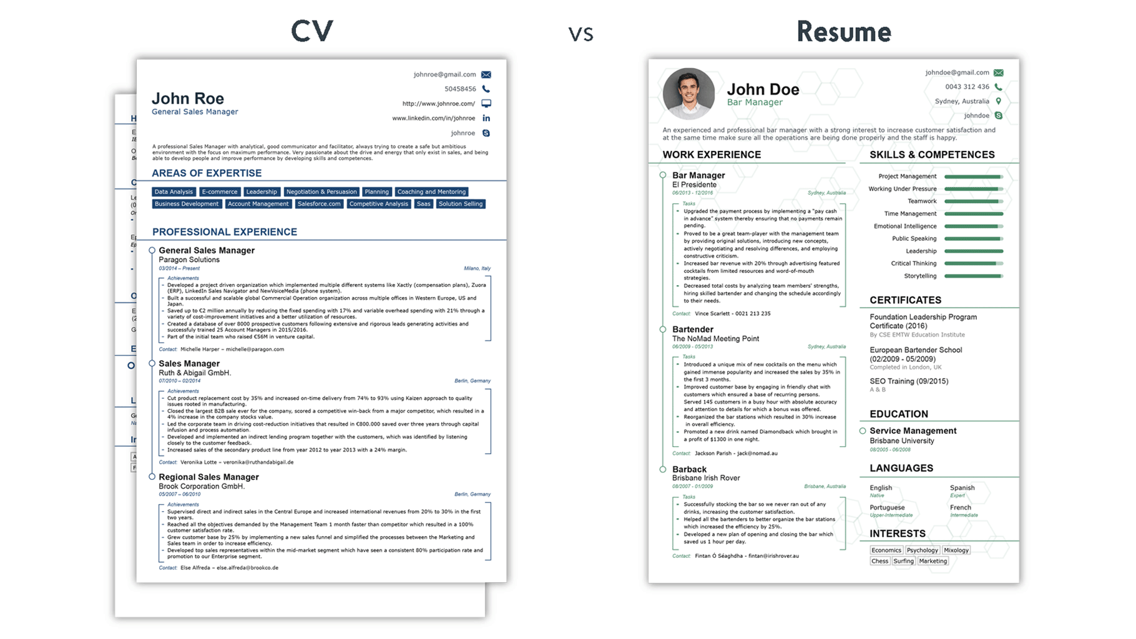
1.CURRICULUM VITAE IS FOR EXPERIENCED
2.RESUME’ IS FOR FRESHERS/BEGINERS

Slide 16
Resume’ Structure
Online Resume’ Offline Resume’

Slide 17
Online Resume’
It should be only one page long.Not more than that.
Structure:
Name:
Dob:
Mail-Id
Active contact number:
Professional Social media profiles: LinkedIn , GitHub,Behance,Youtube Channel Etc.
Blogspace/Website:
Career Objective:
Academic Status/Academic profile:(Latest to oldest)
Skills:
Certifications:
Internships:
Languages Known:
Projects and Papers:

Slide 18
Offline Resume’
It can be one page or two pages long.But not more than that.
Structure:
Name:
Dob:
Mail-Id :
Active contact number:
Professional Social media profiles: LinkedIn , GitHub,Behance,Youtube Channel Etc.
Blogspace/Website:
Career Objective:
Academic Status/Academic profile:(Latest to oldest)
Skills:
Certifications:
Internships:
Projects and Papers:
Area of interests:
References(optional)
Other Personal detalis and Declaration:

Slide 19
Resume’ Tips
Academic Status Structure: QUALIFICATION-INSTITUTION-BOARD-YOP-PERCENTAGE/CGPA
Project and Intern Structure: Name-Period-Role-Content
Work Experience Structure: Challenges Faced- Action Taken-Results in Quantitative( Rate Turnover, Revenue Turnover in numbers.)
Personal Details Structure:
Name:
Age and DOB:
Qualification and Yop(Year of passing) :
Father’s Name and Occupation:
Marital Status:
Option to relocate:

Slide 20
DO’s and DON’Ts For Interview
Typography , Spelling , Punctuation and Capitalization should be given priority in the Resume’.
Avoid Graphics in the resume /but necessary icons can be included in Resume
Read your resume’ once before interview.
Don’t lie about you on interview and in resume.
Multiple resume’s should be sent to multiple companies.As it should be customized accordingly.
Do’s for effective communication:
Read Newspapers
Read Inshots app daily
Adapt a new word daily and use it.

Slide 21
Thanks!
Do you have any questions?
hive@hiveed.in
www.hiveed.in

